Slide 1
Modern Atomic Theory and the Periodic Table
Chapter 10

Slide 2
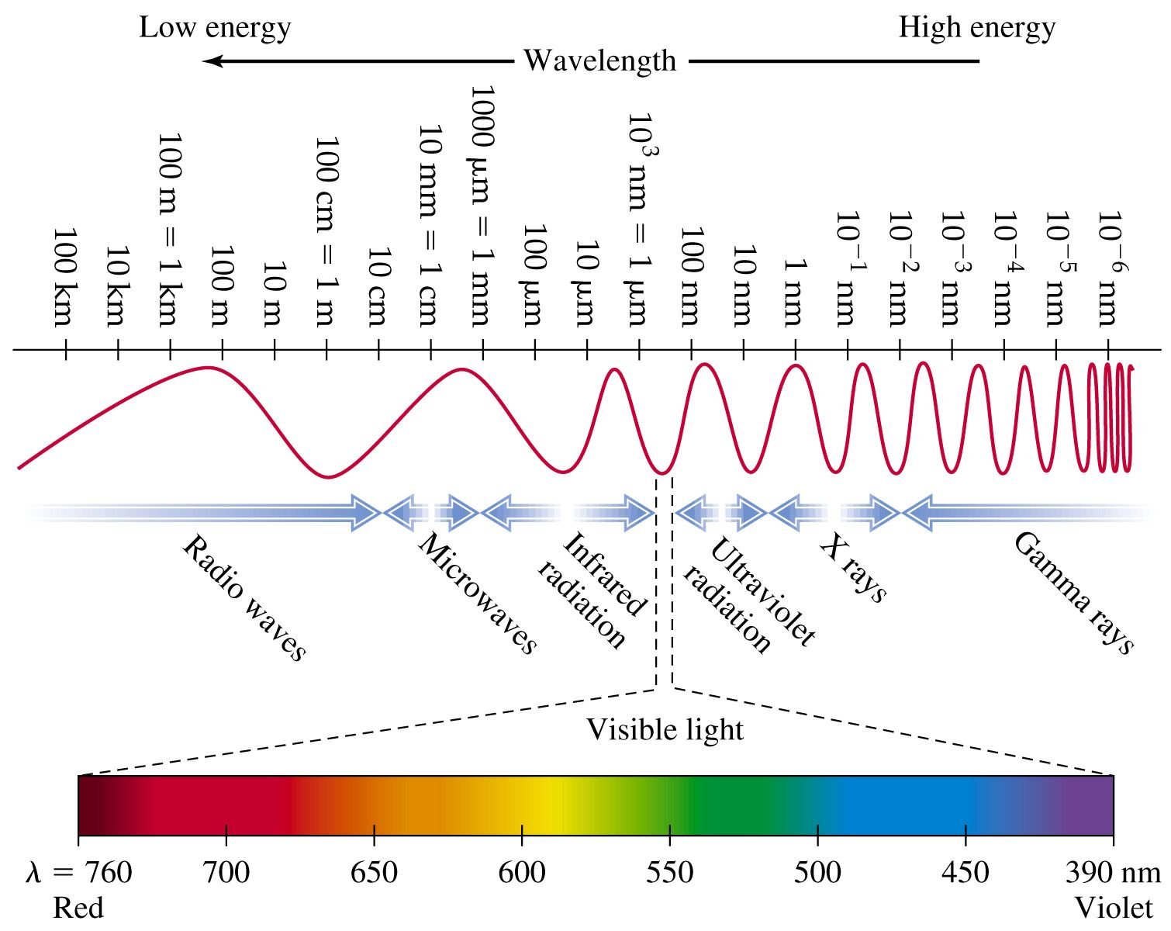

Slide 3
Experiment 1
Add an elemental gas to a cathode ray tube and get ----- colors
Hydrogen (H₂) purple blue
Neon (Ne) red orange
Helium (He) yellow pink
Argon (Ar) lavender
Xenon (Xe) blue

Slide 4
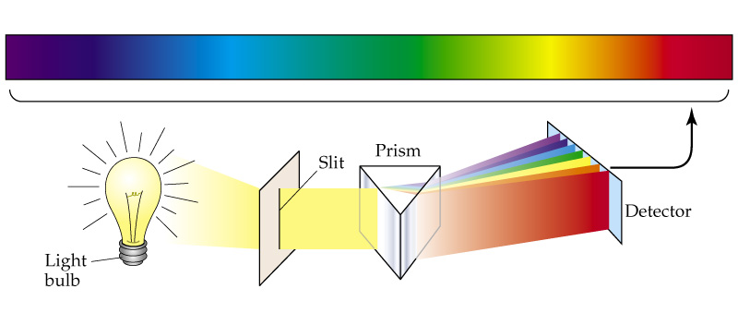
Experiment 2
Shine white light through a prism -- rainbow
A prism separates light of different wavelength, each color represents a different wavelength.

Slide 5
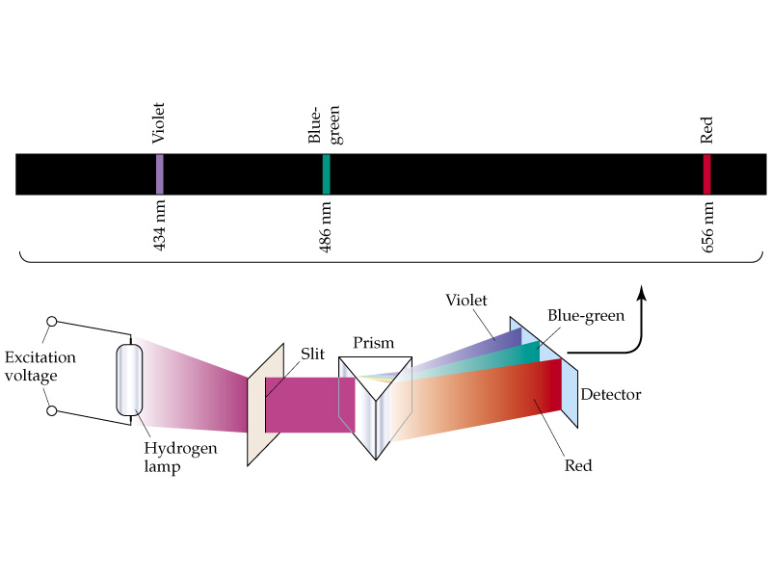
Experiment 3
Shine the colored light from our gas discharge tubes through a prism ⎯→ get distinct bands of color (light).
http://jersey.uoregon.edu/vlab/elements/Elements.html

Slide 6
Bohr model of the atom
Electrons orbit the nucleus like little planets (planetary model) each with its own energy. Electrons can move from one energy level to another by absorbing or releasing energy.
Energy is released as radiant energy or light.

Slide 7
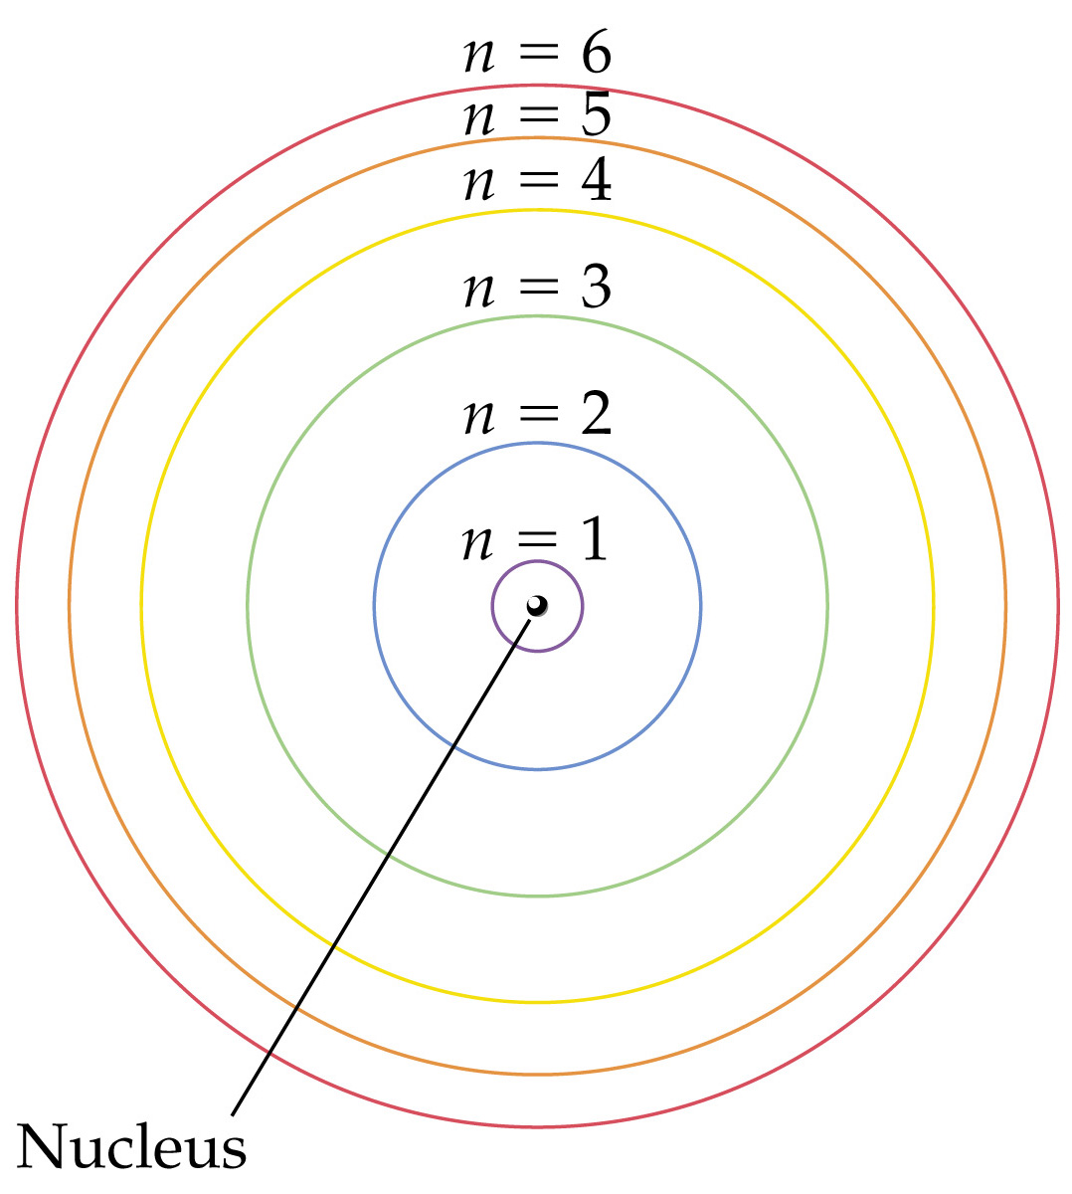
Notes:
Figure: 09-09
Title:
The Bohr model of the atom, showing electron orbits

Slide 8
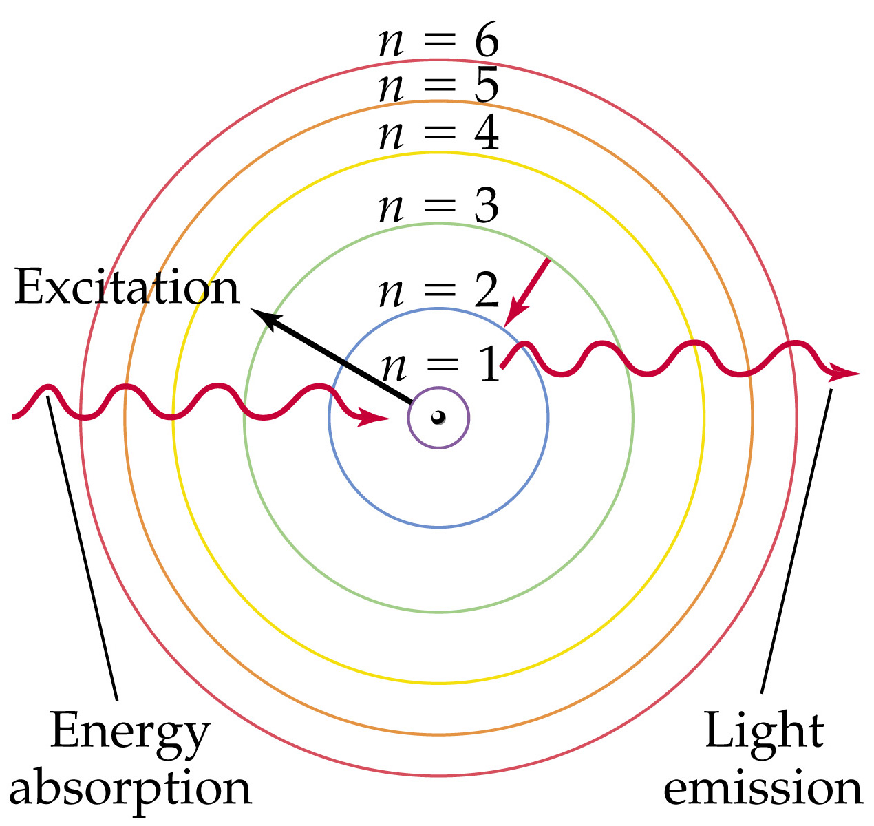
Notes:
Figure: 09-11
Title:
Energy absorption and light emission in a Bohr hydrogen atom

Slide 9
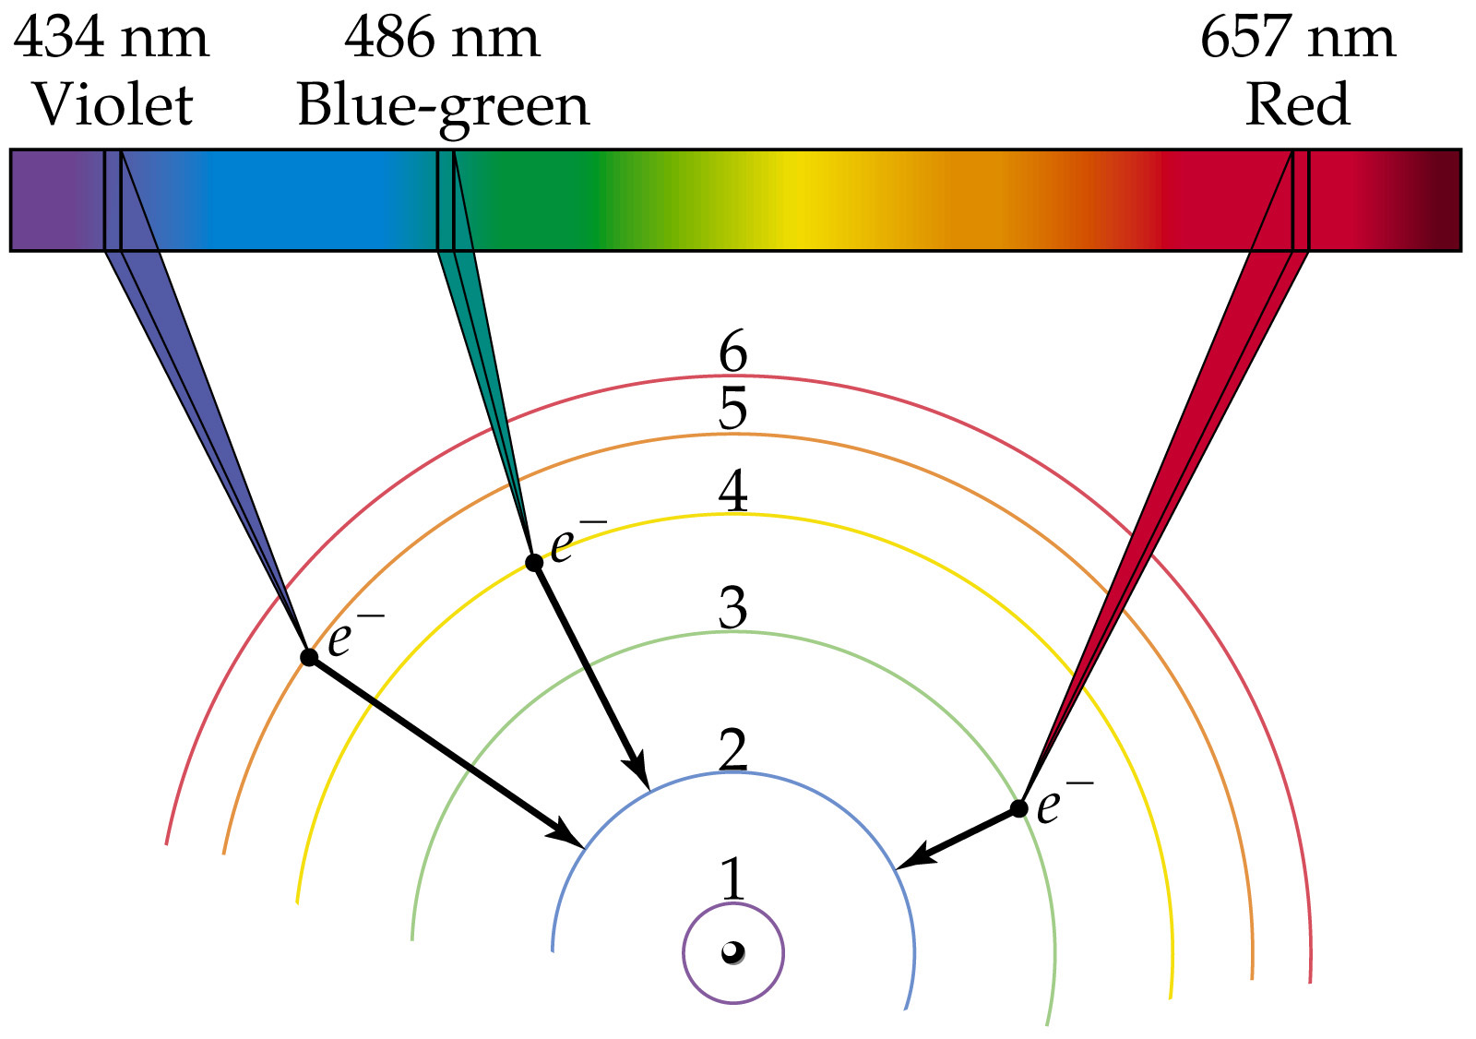
Notes:
Figure: 09-12
Title:
Visible lines in emission spectrum of a Bohr hydrogen atom

Slide 10
Quantum of energy
the smallest quantity of energy that can be emitted (or absorbed) in the form of electromagnetic radiation.

Slide 11
Schrodinger’s quantum mechanical model of the atom
Eψ = Hψ
ψ is the wave function or orbital
ψ² (probability function) represents the probability of finding an electron at any given position in an atom.

Slide 12
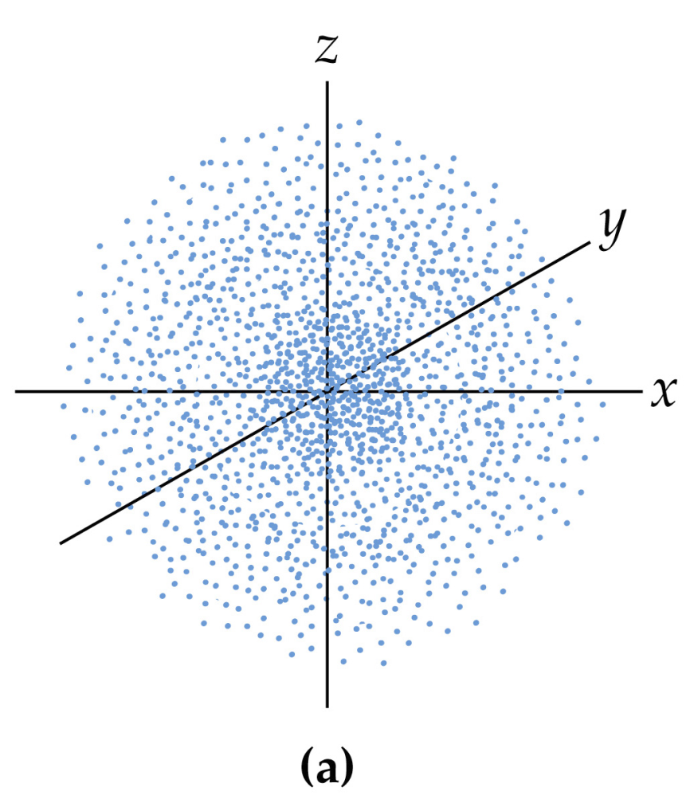
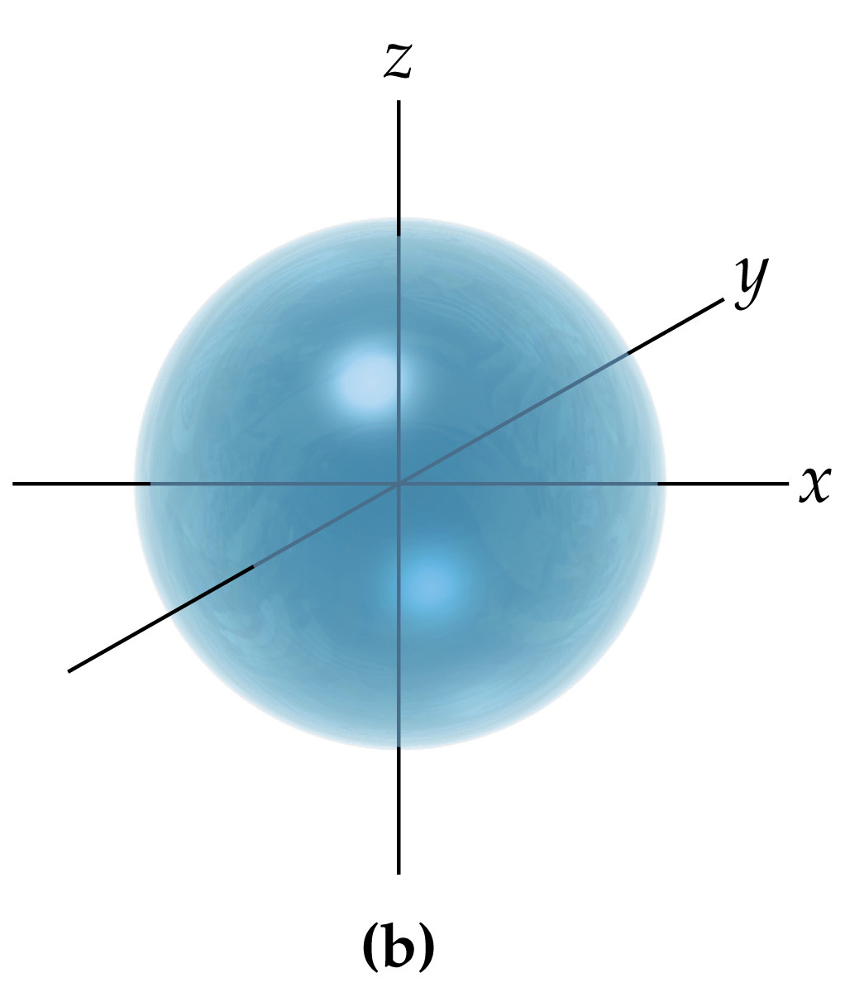
s orbitals
• spherical in shape
Electron density map
Representation of volume of orbital

Slide 13
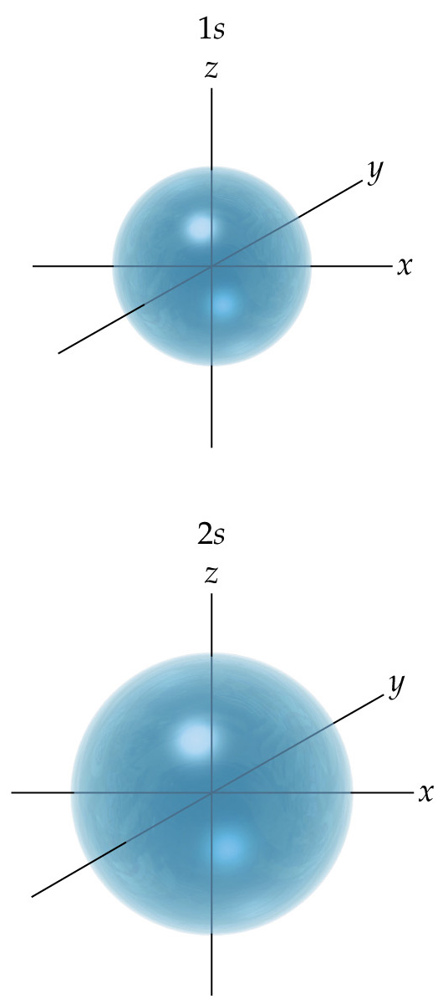
Notes:
Figure: 09-20
Title:
Comparison of 1s and 2s orbitals

Slide 14
p orbitals
• dumbbell shaped
• three different spatial orientations

Slide 15
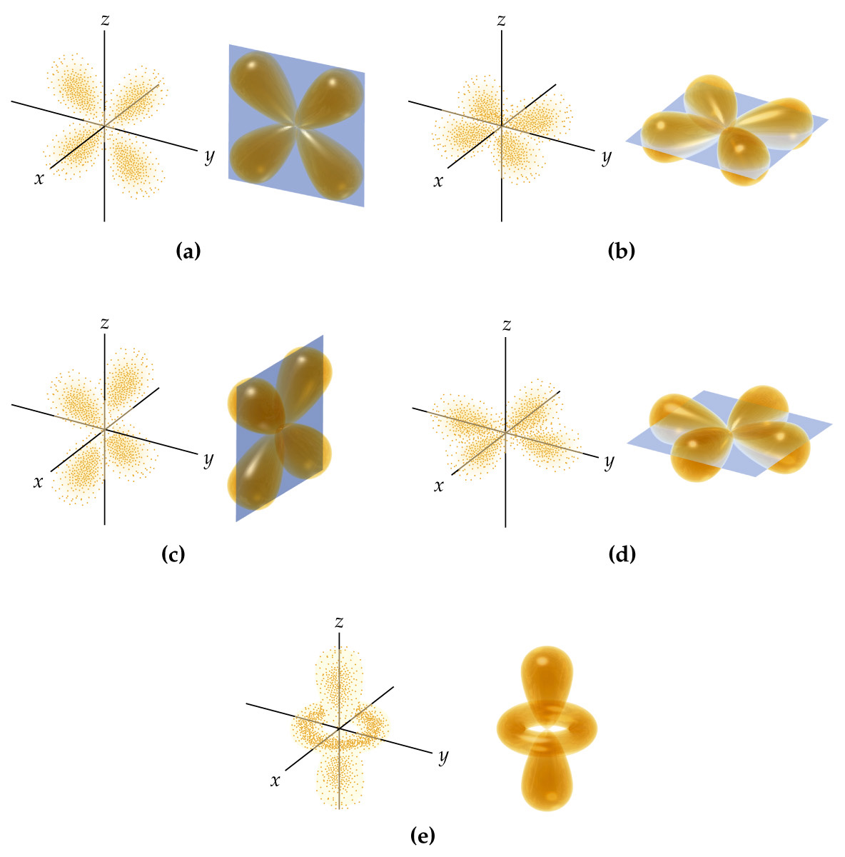
d orbitals

Slide 16
f orbitals
Complex shapes
7 different orientations

Slide 17
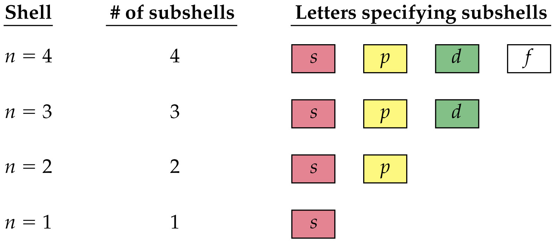
Notes:
Figure: 09-19
Title:
Shells are organized into subshells

Slide 18
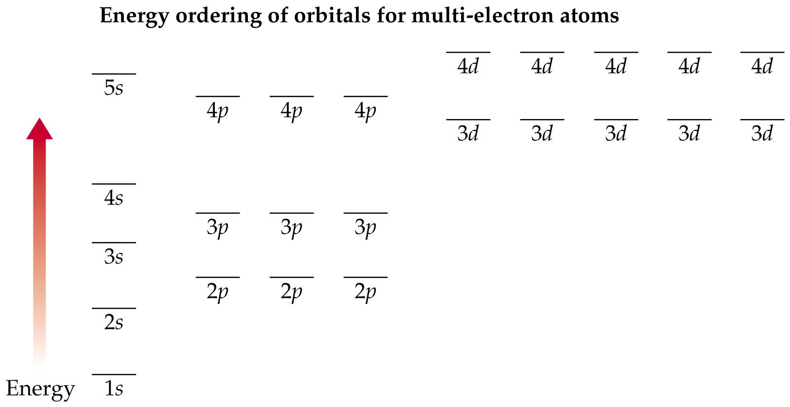

Slide 19
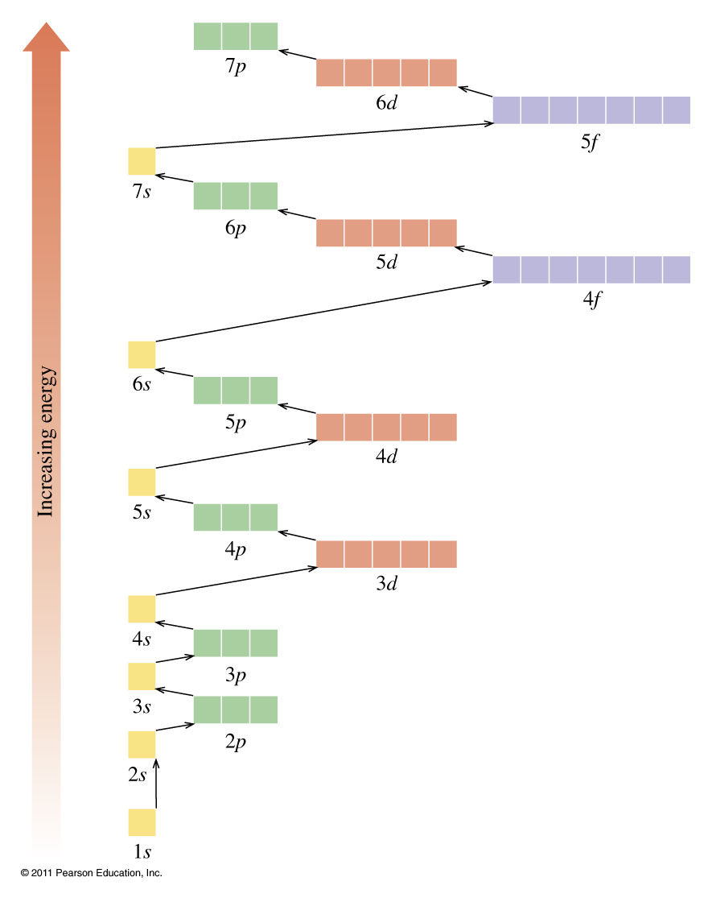

Slide 20
Electronic configuration of the atoms
Rules for filling orbitals
1. Lowest energy orbitals are filled first.
2. Only 2 electrons (of different spin) allowed in each orbital.
3. When sublevels are filling, fill each orbital with 1 electron of same spin and then pair openly when necessary

Slide 21
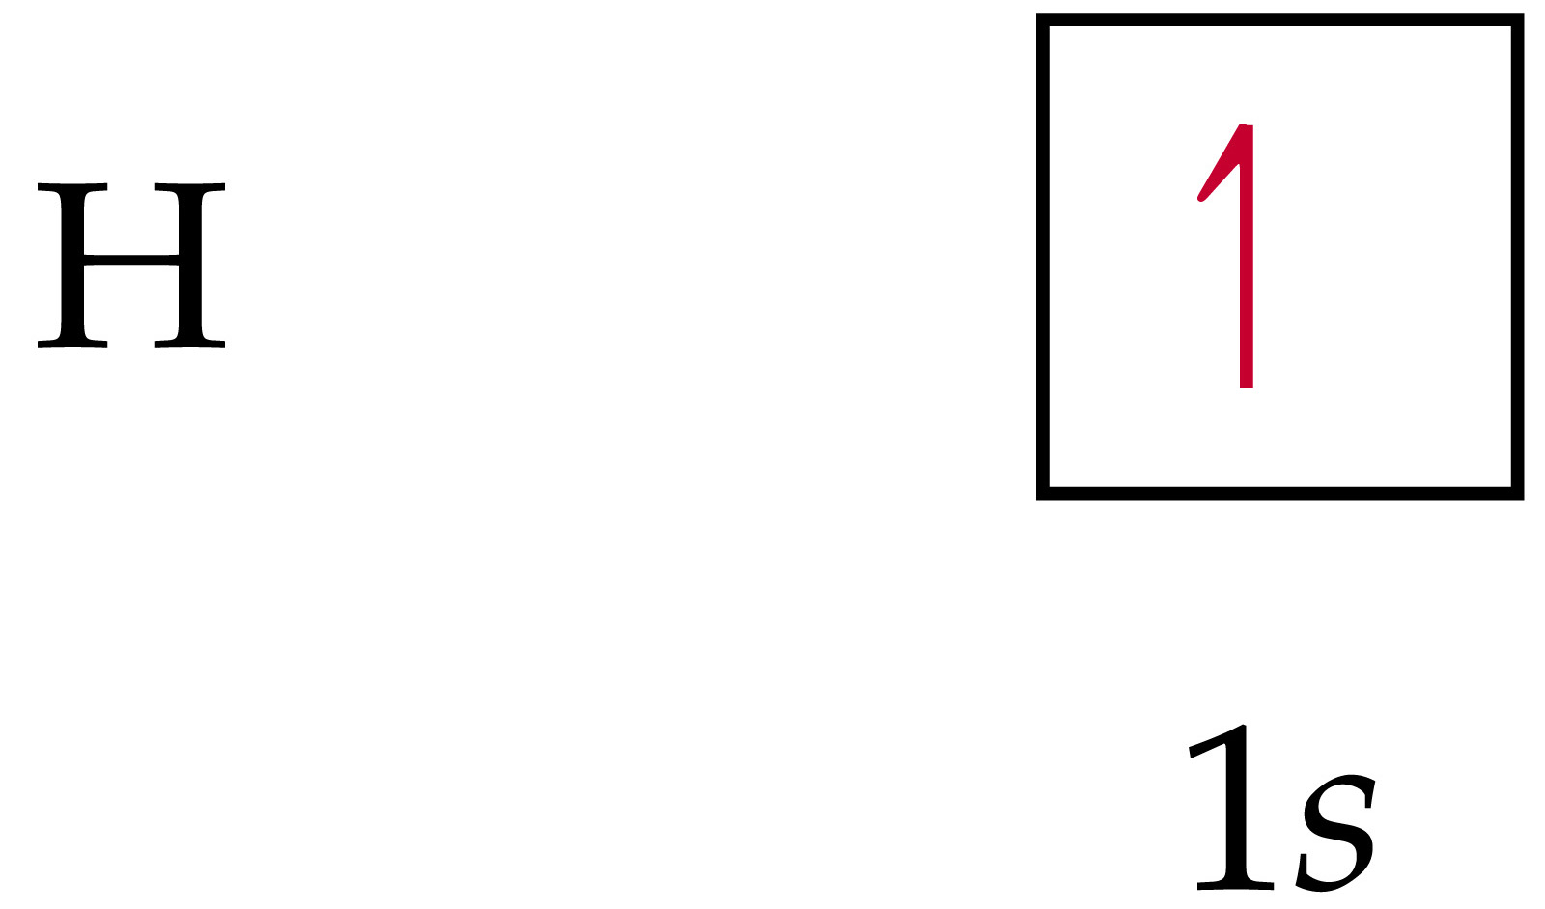
Notes:
Figure: 09-25-02un
Title:
Orbital diagram for a ground state hydrogen atom

Slide 22
Notes:
Figure: 09-25-03un
Title:
Orbital diagram and electron configuration for a ground state helium atom

Slide 23
Notes:
Figure: 09-26-01un
Title:
Orbital diagram and electron configuration for a ground state lithium atom

Slide 24
Notes:
Figure: 09-26-02un
Title:
Orbital diagram and electron configuration for a ground state carbon atom

Slide 25
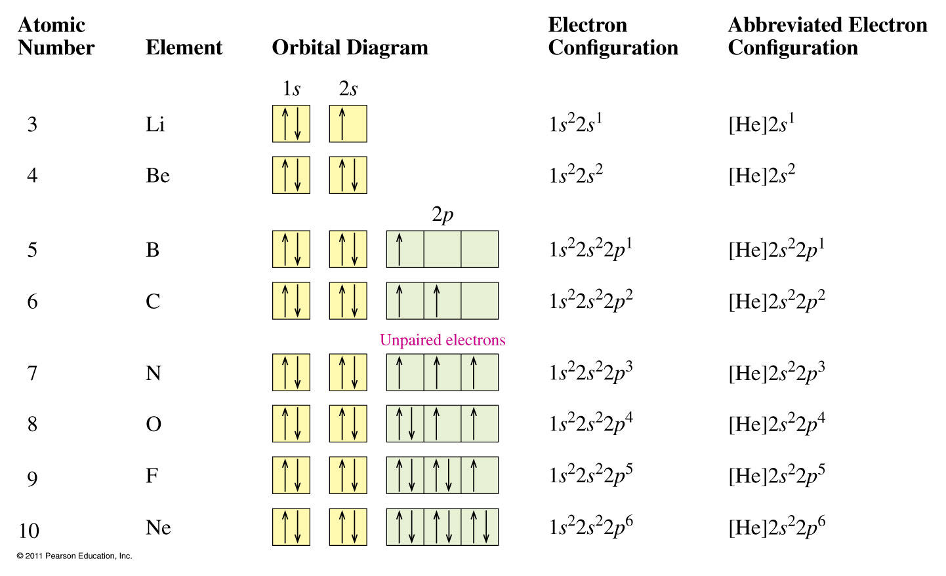

Slide 26
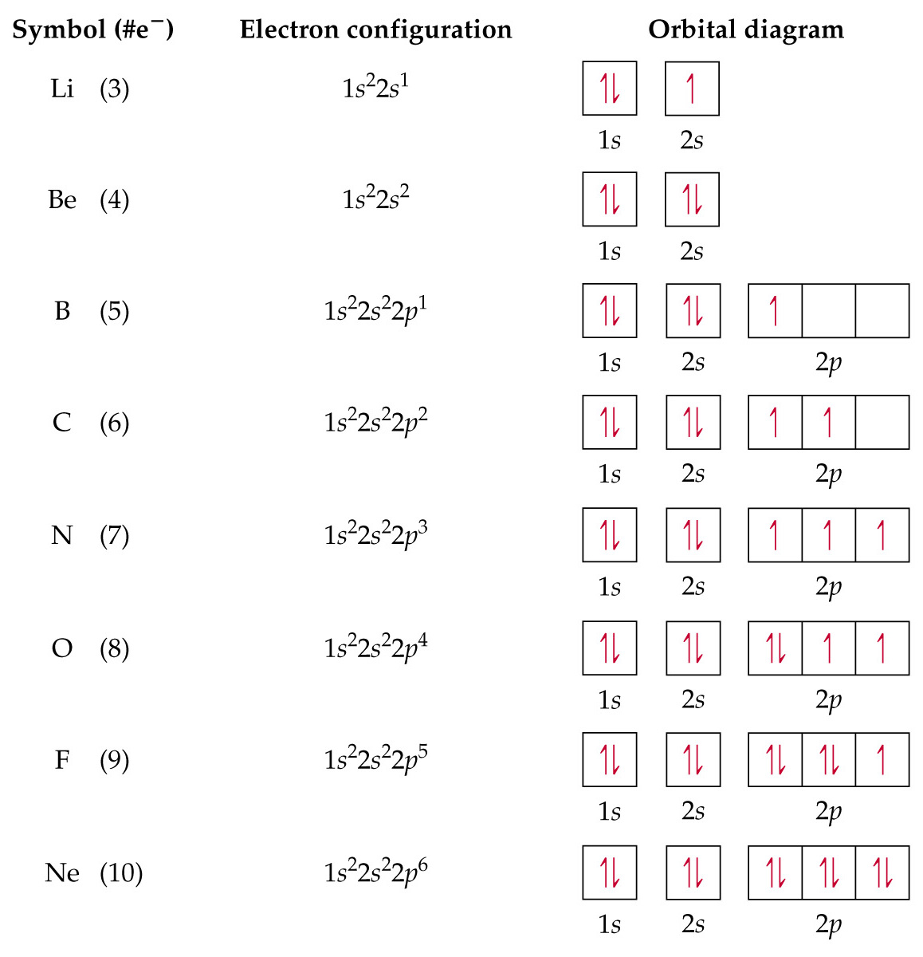
Notes:
Figure: 09-27-01un
Title:
Orbital diagram and electron configuration for eight elements in the ground state

Slide 27
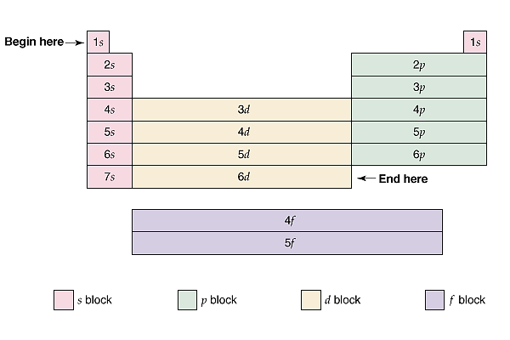

Slide 28
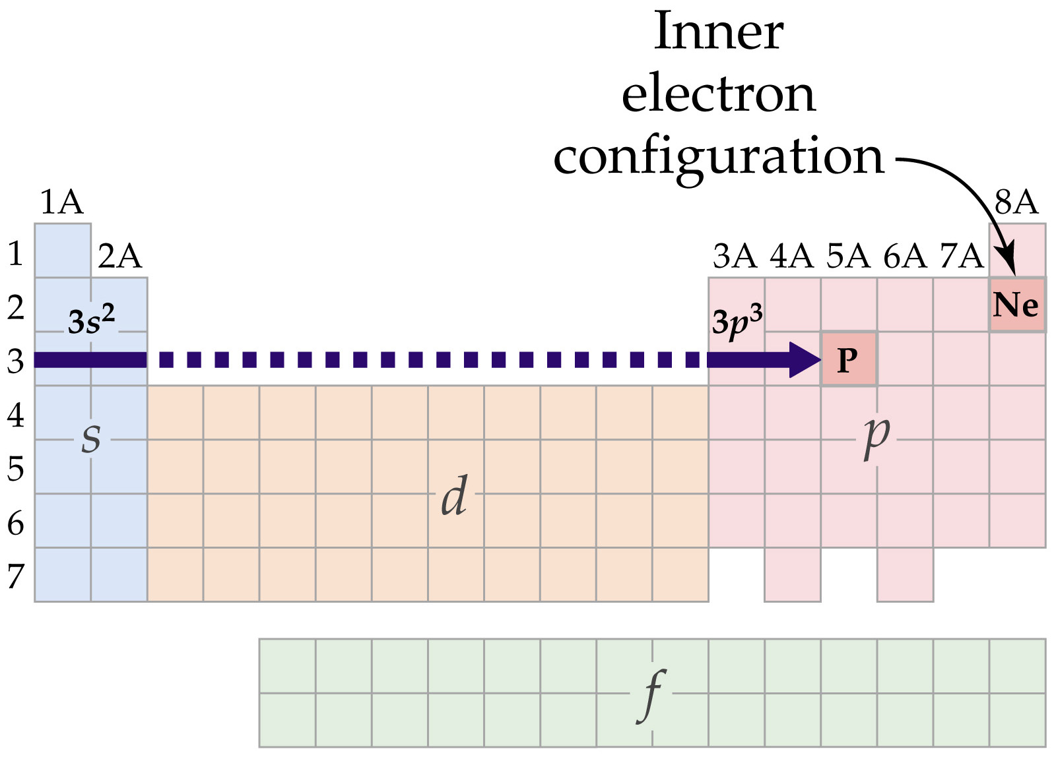
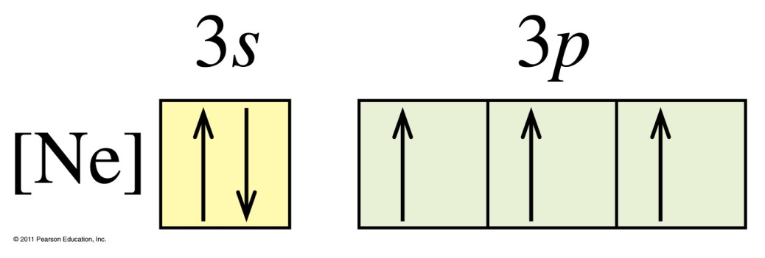
Phosphorous

Slide 30
Notes:
Figure: 09-30
Title:
The periodic table gives the electron configuration for P

Slide 31
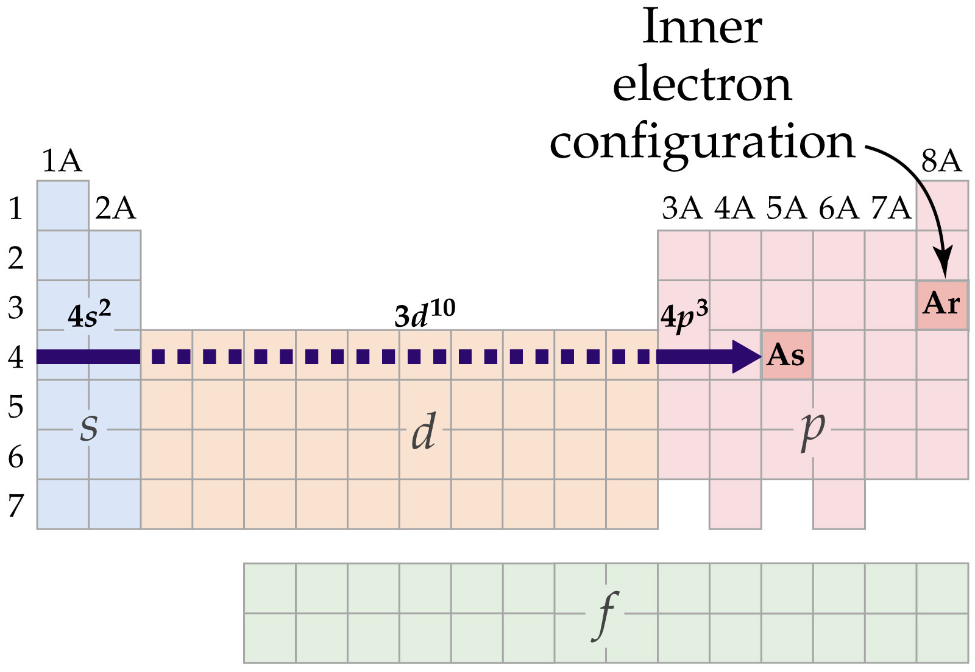
Notes:
Figure: 09-31
Title:
The periodic table gives the electron configuration for As

Slide 32
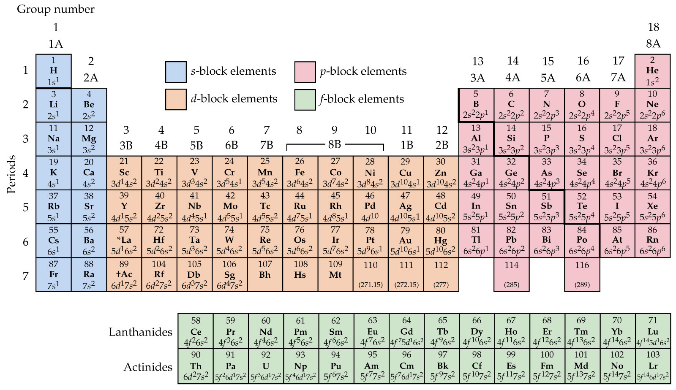
Notes:
Figure: 09-29
Title:
Outer electron configuration for the elements

Slide 33
Descriptive Chemistry
Alkali Metals
Alkaline Earths
Aluminum
Halogens
Nobel Gases

Slide 34
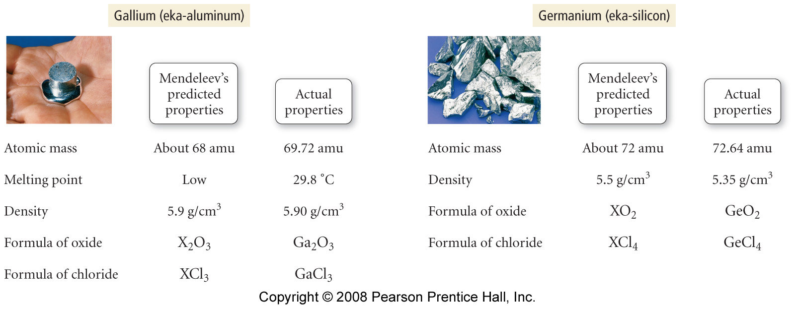
Mendeleev’s Original Periodic Table

Slide 35
Notes:
Figure: 08-20
Title:
Reactions of the Alkali Metals with Water
Caption:
The reaction becomes progressively more vigorous as you move down the group.

Slide 36
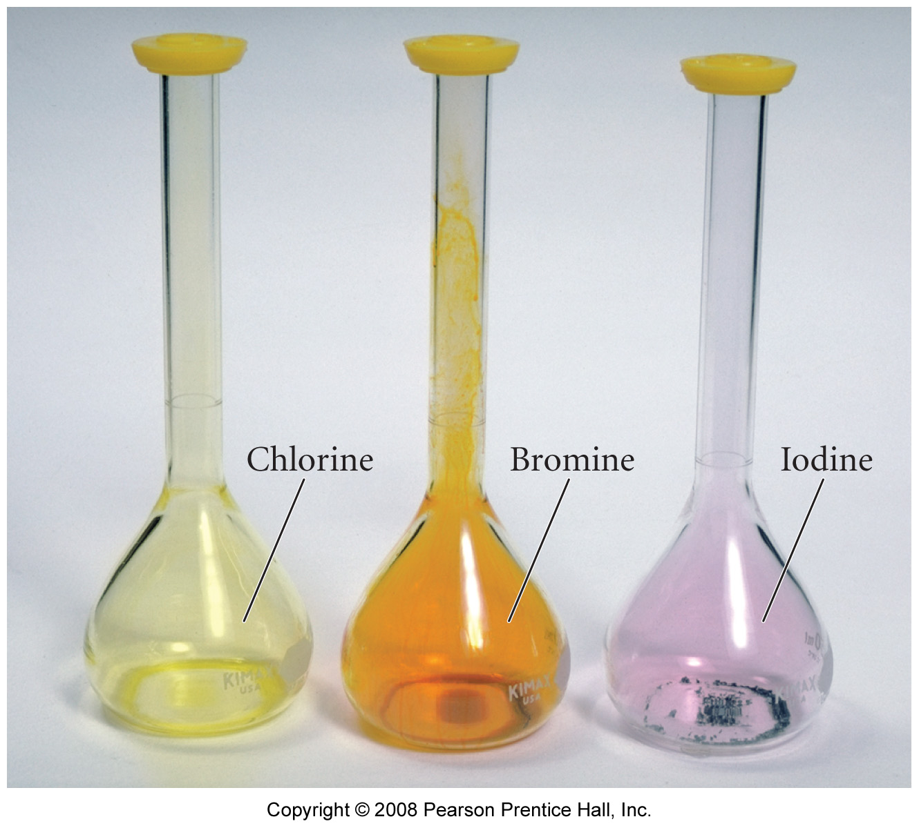
Notes:
Figure: 08-20-01UN
Title:
Chlorine, Bromine, Iodine
Caption:
The most commonly encountered halogens.

Slide 37
Notes:
Figure: 08-T04
Title:
TABLE 8.4 Properties of the Noble Gases
Caption:
The listed properties show several trends that can be explained by chemistry.

